Slide 1
NIST Cybersecurity Framework (CSF) It is a Framework; it is a tool to help everyone understand security threats CSF is used for implementing security process, policies, and procedures addressing risk History of NIST Originally founded by the United States Congress on March 3, 1901, the mission of the National Institute of Standards and Technology (NIST) is promoting innovation and industrial competitiveness, NIST focuses on a wide range of topics including advanced communications, advanced manufacturing, forensics, health and bioscience, and cybersecurity. NIST enables standardized commerce across the us and across continents. NIST has been instrumental in the development of neon lights, railroad track gauge, electrical safety, digital imaging, and data encryption standards Executive Order 13636 (policy to enhance security) It is the policy of the US to enhance the security of the nation’s critical infrastructure. A Framework for reducing risks to critical infrastructure Sharing cybersecurity threat information Maintain a cyber-environment for safety, security and privacy. Shortly thereafter, NIST released a series of requests for information (RFIs) to collect information on what standards industry was currently using and to create industry awareness of the forthcoming endeavor. From the beginning in 2013 the latest revision in 2018, the CSF has been developed with the input form government, industry and individuals

Slide 2
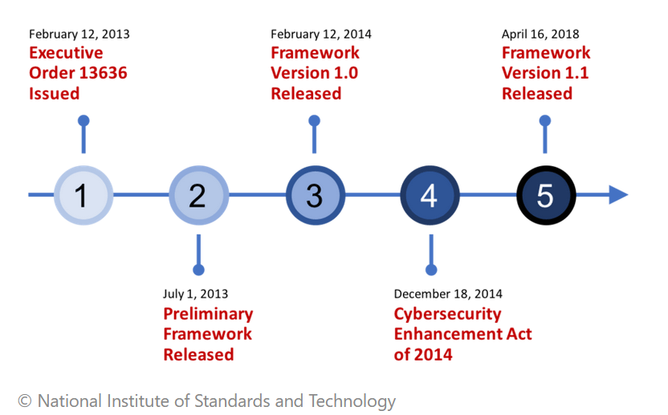

Slide 3
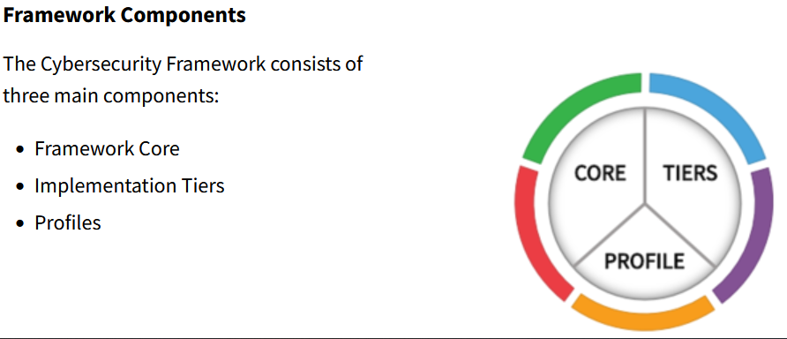
NIST Cybersecurity Framework

Slide 4
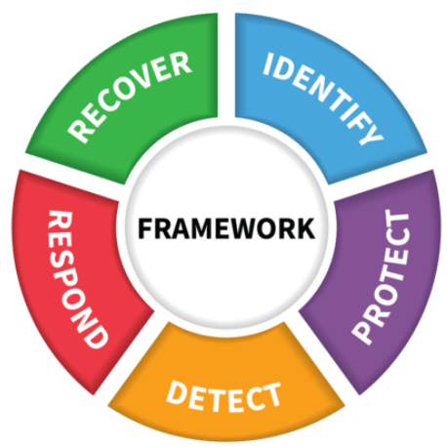
Component 1: FRAMEWORK CORE The Five Functions
Highest level of abstraction in the core
Represent five key pillars of a successful and wholistic cybersecurity program
Aid organizations in expressing their management of cybersecurity risk at a high level
Notes:
The five Functions included in the Framework Core are:
Identify
Protect
Detect
Respond
Recover
The Functions are the highest level of abstraction included in the Framework. They act as the backbone of the Framework Core that all other elements are organized around.
These five Functions were included in the Core because they represent the five primary pillars for a successful and holistic cybersecurity program. They aid organizations in easily expressing their management of cybersecurity risk at a high level and enabling risk management decisions.

Slide 5
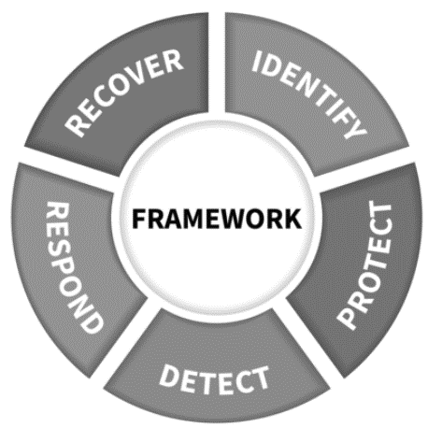

The Identify Function
The Identify Function assists in developing an organizational understanding of managing cybersecurity risk to systems, people, assets, data, and capabilities
Example Outcomes:
Identifying physical and software assets to establish an Asset Management program
Identifying cybersecurity policies to define a Governance program
Identifying a Risk Management Strategy for the organization. Identifying Risk Assets vulnerabilities and threats
Identify a Supply Chain Risk Management Strategy

Slide 6

The Protect Function
The Protect Function supports the ability to limit or contain the impact of potential cybersecurity events and outlines safeguards for delivery of critical services
Example Outcomes:
Establishing Data Security protection to protect the confidentiality, integrity, and availability
Managing Protective Technology to ensure the security and resilience of systems and assists
Empowering staff within the organization through Awareness and Training
Implementing Protection Process Procedures

Slide 7
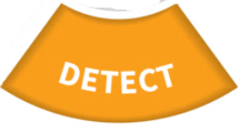
The Detect Function
The Detect Function defines the appropriate activities to identify the occurrence of a cybersecurity event in a timely manner
Example Outcomes:
Implementing Security Continuous Monitoring capabilities to monitor cybersecurity events
Ensuring Anomalies and Events are detected, and their potential impact is understood
Verifying the effectiveness of protective measures

Slide 8
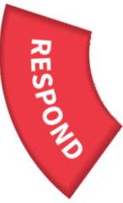
The Respond Function
The Respond Function includes appropriate activities to take action regarding a detected cybersecurity incident to minimize impact
Example Outcomes:
Ensuring Response Planning processes are executed during and after an incident
Managing Communications during and after an event
Analyzing effectiveness of response activities.
Implement improvements

Slide 9

The Recover Function
The Recover Function identifies appropriate activities to maintain plans for resilience and to restore services impaired during cybersecurity incidents
Example Outcomes:
Ensuring the organization implements Recovery Planning processes and procedures
Implementing improvements based on lessons learned
Coordinating communications during recovery activities

Slide 10
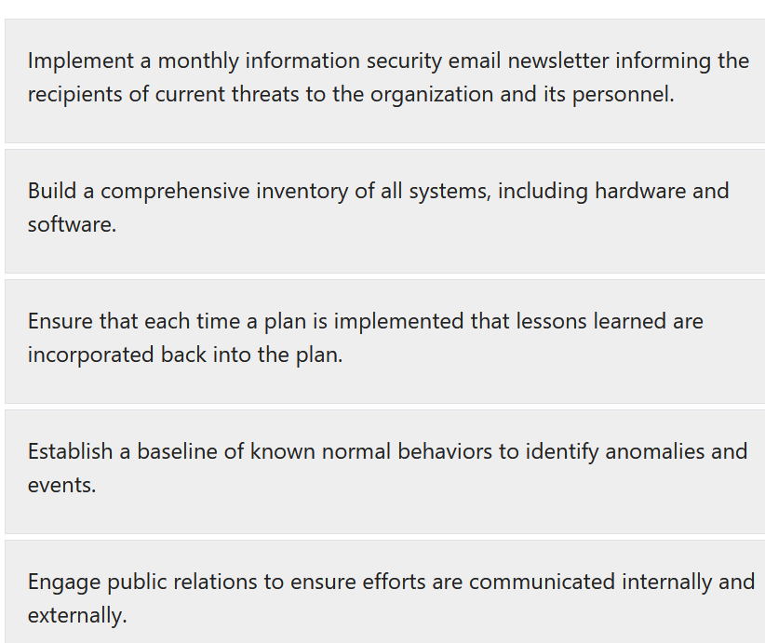
Examples
Protect
Identify
Recover
Improvement
Detect
Recover communications
10

Slide 11
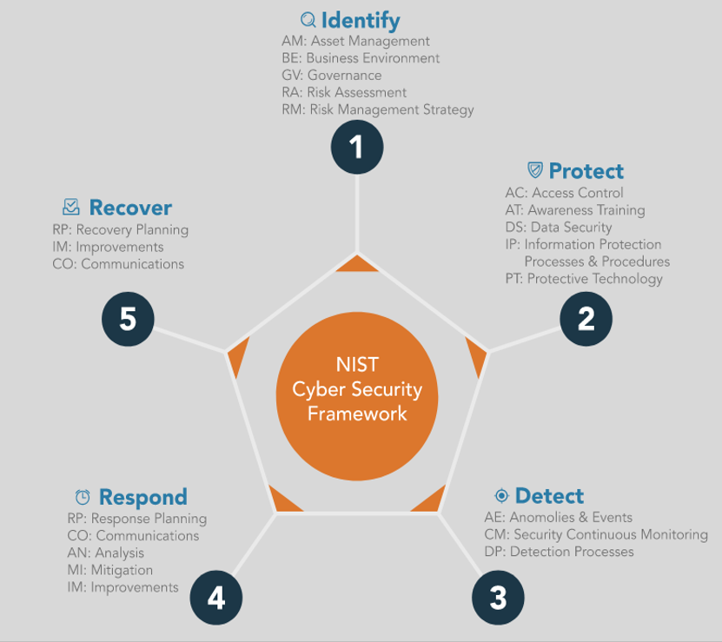
Summary

Slide 12
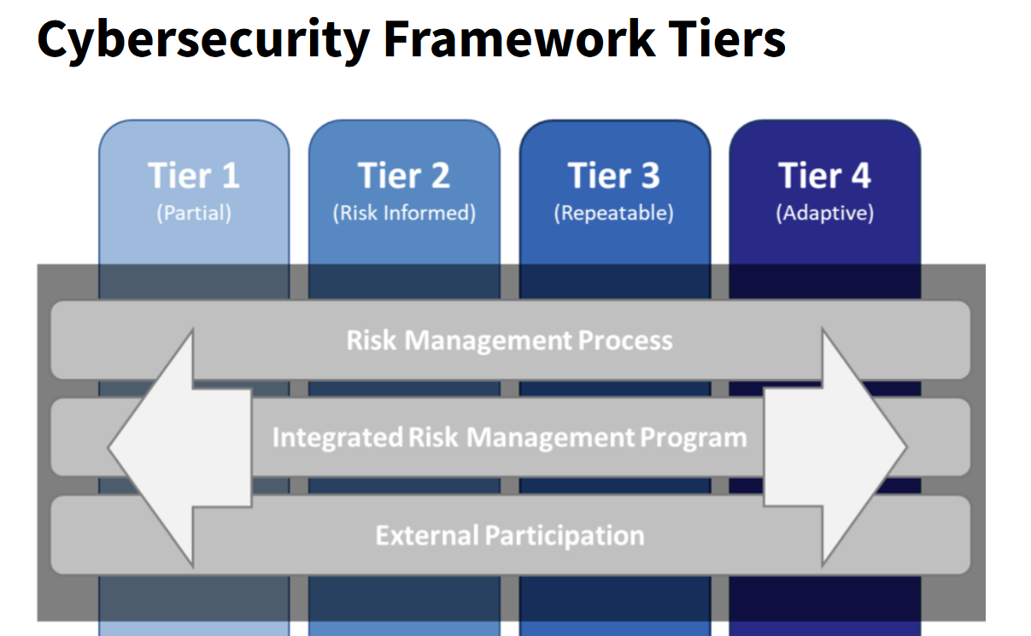
Component 2: Implementation Tiers
The CSF is designed to be useful for all areas of the industry.
Implementation tiers aid that mission by providing multiple tiers based on your organization risks appetite
The NIST CSF describes 4 Tiers to aid in implementation
Tiers are tools to help the organization identify decisions regarding cybersecurity
Think of Tiers as the preferred outcome of activity

Slide 13
Tier 1 - Partial:
Reactive to situations
No formalized security process
Does not participate in any information sharing activities
Tier 2 – Risk Informed:
Policies may exist, but are known to only a few key people
Threats are recognized, but may not be efficiently communicated to even internal parties
Acts upon risks based on external intelligence, but probably not consistently
Tier 3 – Repeatable:
Organization has implemented CSF standards
Has formal policy that is updated on a regular basis
Organization can repeatedly respond to cyber crises
Tier 4 – Adaptable:
Can quickly adapt to new and emerging threats
Understands their place in the cyber supply chain and actively works to protect others
Risk management is built into culture so everyone is able to recognize risk

Slide 14
Component 3: Profiles
Profiles are both outlines of an organization’s current cybersecurity status and roadmaps toward CSF goals for protecting critical infrastructure. NIST said having multiple profiles—both current and goal—can help an organization find weak spots in its cybersecurity implementations and make moving from lower to higher tiers easier.
Profiles also help connect the functions, categories and subcategories to business requirements, risk tolerance and resources of the larger organization it serves. Think of profiles as an executive summary of everything done with the previous three elements of the CSF.

Slide 15
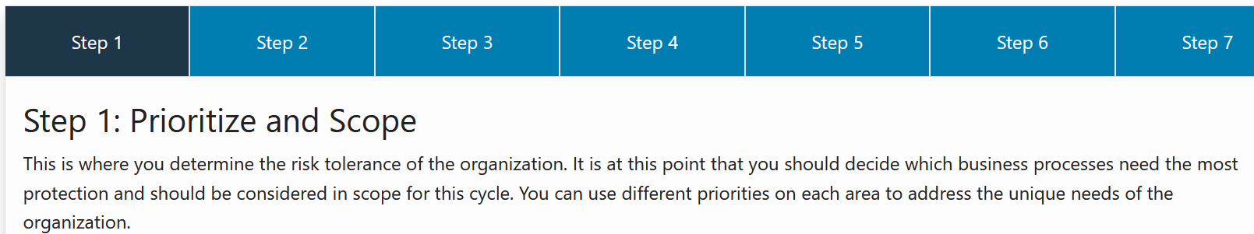
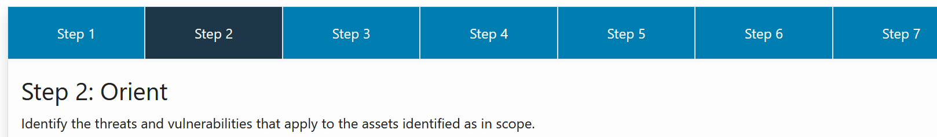
Implementing a Cybersecurity Framework

Slide 16
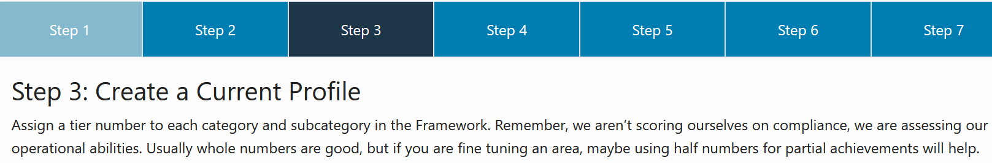
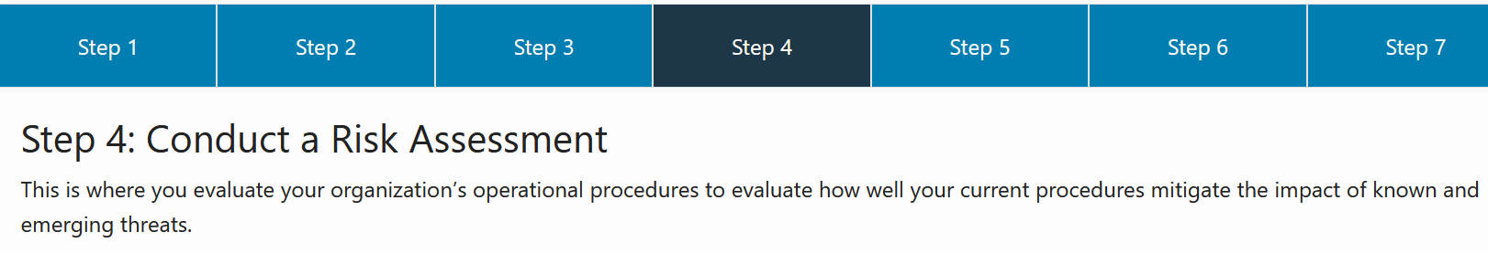
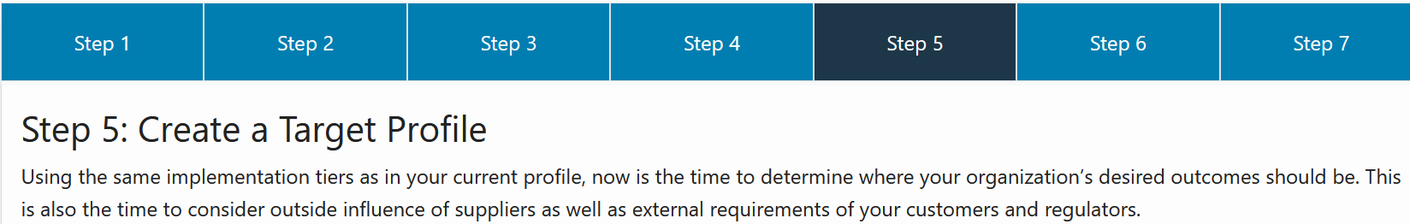

Slide 17
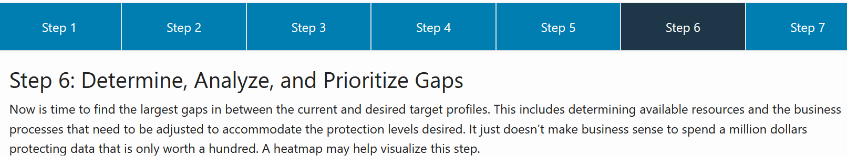
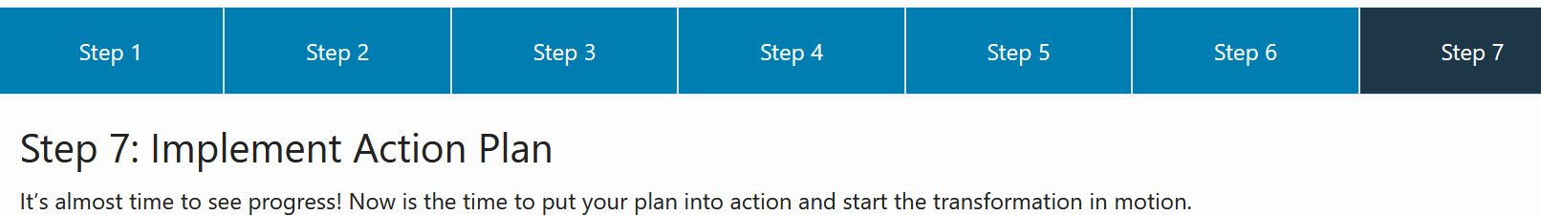
This all becomes second-nature and develops into a repeatable process with practice and deployment. Annual cycles are adequate for most organizations, but you should customize to your needs and goals. Some start out as a monthly process and gradually stretch out as high-priority items are folded into the continuous cycle. Remember, this requires constant and consistent communication with all stakeholders regarding the current and desired tiers for your organization.

